Slide 1
INTRODUCTION
Steganography :
Steganography comes from the Greek word, it means covered or secret writing.
STEGAN-O-GRAPHY
covered writing

Slide 2
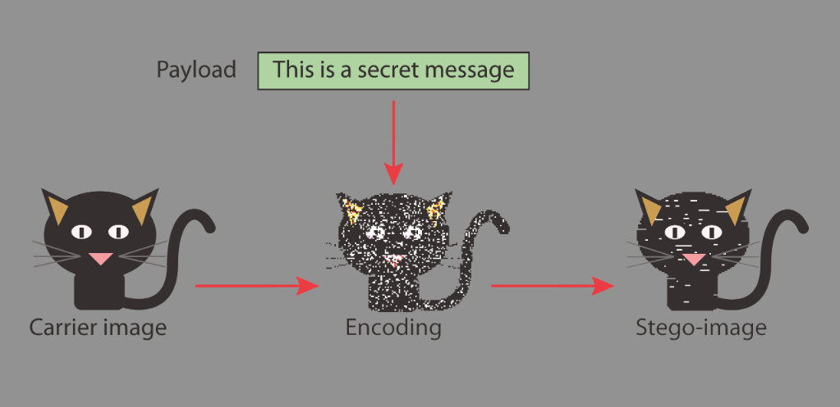
“The goal of steganography is to hide messages in such a way that no one apart from the intended recipient even knows that a message has been sent.”
This can be achieve by concealing the existence of information within seemingly harmless carriers or cover
It can be understand by the following figure.

Slide 3
Block diagram of Steganography

Slide 4
STEGANOGRAPHY UNDER VaRIOUS MEDIA
Steganography in “TEXT”
Steganography in “IMAGES”
Steganography in “AUDIO”

Slide 5
STEGANOGRAPHY IN TEXT
It involves three types of coding:
Line-Shift Coding : Here, text lines are vertically shifted to encode the document uniquely.
Word-Shift Coding : The codewords are coded into a document by shifting the horizontal locations of words within text lines, while maintaining a natural spacing appearance.
Feature Coding : In feature coding, certain text features are altered, or not altered, depending on the codeword.

Slide 6
STEGANOGRAPHY IN IMAGES
Image Compression:
Image compression offers a solution to large image files. Two kinds of image compression are lossless and lossy compression. Both methods save storage space but have differing effects on any uncompressed hidden data in theimage.
“Lossy” JPEG(Joint Photographic Experts Group) format files, offers high compression, but may not maintain the original image's integrity. Hence it is called “lossy”.
“Lossless” compression maintains the original image data exactly, It is thus more favored by steganographic techniques. Eg: (BMP ),(GIF) Formats.

Slide 7
STEGANOGRAPHY IN IMAGES
Image Encoding Techniques
The most common approaches to information hiding in images :
Least Significant bit insertion :
Masking and Filtering :
Algorithms and transformations :

Slide 8
STEGANOGRAPHY IN AUDIO
Audio Environments
Digital representation
Sample quantization method :
Temporal sampling rate :
Another digital representation :

Slide 9
STEGANOGRAPHY IN AUDIO
Transmission medium :
Bender’s transmission environments
Digital end-to-end environment.
Increased/decreased resampling environment.
Analog transmission and resampling.
''Over the air'' environment.

Slide 10
STEGANOGRAPHY IN AUDIO
Methods of Audio Data Hiding
Low-bit encoding :
Phase coding :
Echo data hiding :

Slide 11
STEGANALYSIS
Steganalysis is the art and science of detecting a secret communication.
Hiding a message will most likely leave detectable traces in the cover medium.
The information hiding process changes the statistical properties of the cover, which is a steganalyst attempts to detect.
The process of attempting to detect statistical traces is called statistical steganalysis.

Slide 12
STEGANALYSIS
IMPORTANT ASPECTS OF STEGANALYSIS
DETECTING HIDDEN INFORMATION
DISABLING STEGANOGRAPHY

Slide 13
APPLICATIONS
Confidential communication and secret data storing.
Protection of data alteration.
Access control system for digital content distribution.
Media Database systems.

Slide 14
ADVANTAGES AND DISADVANTAGES
ADVANTAGES :
Difficult to detect and Only receiver can detect.
It can be done faster with large no. of softwares.
Provides better security for sharing data in LAN,MAN & WAN.
DISADVANTAGES :
The confidentiality of information is maintained by the algorithms, and if the algorithms are known then this technique is of no use.
Password leakage may occur and it leads to the unauthorized access of data.
If this technique is gone in the wrong hands like hackers can be very much dangerous for all.

Slide 15


